Slide 1
Lecture 19
The Null and Alternative Hypotheses
The t test

Slide 2



The Null and Alternative Hypotheses
H₀: null hypothesis
--- tentative assumption about a population parameter
H₁: alternative hypothesis
Begin with the assumption that the null hypothesis is TRUE. (Similar to the notion of innocent until proven guilty)

Slide 3
The Null and Alternative Hypotheses
Because of focusing on type I error instead of type II error, we usually regard type I error as having more serious consequences than type II error.
Hence, in formulating null and alternative hypotheses, we use the more conservative hypothesis as the null hypothesis, and will only reject it when the data provide statistically significant (统计上显著) evidence against it.

Slide 4
Example 1
The label on a can of Cutebaby Milk Powder states that the can contains 400 grams of milk powder. The inspection bureau knows that Cutebaby's production process cannot place exactly 400 grams of milk powder in each can, even if the mean filling weight for the population of all cans filled is 400 grams per can. However, as long as the population mean filling weight is at least 400 grams per can, the rights of consumers will be protected. Thus, the inspection bureau interprets the label information on a can of milk powder as a claim by Cutebaby that the population mean filling weight is at least 400 grams per can. The inspection bureau wants to check Cutebaby's claim.

Slide 5
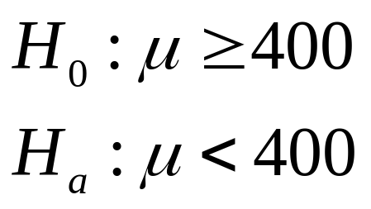
Example 1

Slide 6
Example 2
A real estate research firm tracks the cost of apartment rentals in Beijing. In the first half of 2011, the mean apartment rental rate in Beijing was 3280 yuan per month. In a study, the firm wants to learn whether the population mean apartment rental rate now exceeds the level reported for the first half of 2011.

Slide 7
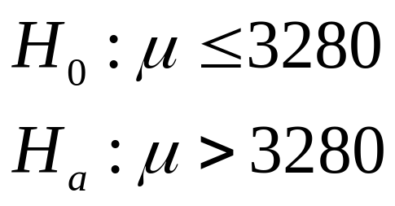
Example 2

Slide 8
Example 3
The Golf Association establishes rules that manufacturers of golf equipment must meet if their products are to be acceptable for use in the Association events.
MaxFlight uses a high-technology manufacturing process to produce golf balls with a mean driving distance of 295 yards. Sometimes, however, the process gets out of adjustment and produces golf balls with a mean driving distance different from 295 yards.

Slide 9
Example 3
When the mean distance falls below 295 yards, the company worries about losing sales because the golf balls do not provide as much distance as advertised. When the mean distance passes 295 yards, MaxFlight's golf balls may be rejected by the Association for exceeding the overall distance standard.
MaxFlight’s quality control program wants to determine whether the process has fallen out of adjustment.

Slide 10
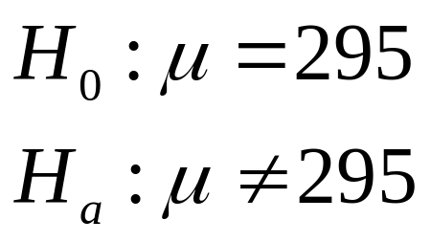
Example 3

Slide 11
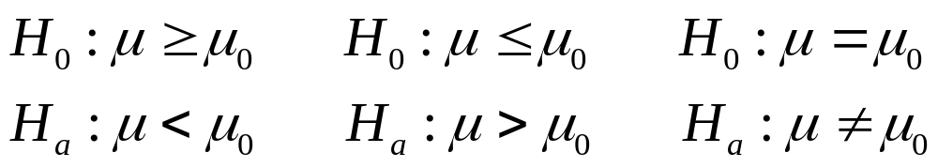
Three Forms of Hypothesis Tests
one-sided test
(or one-tailed test)
单边检验
(或单尾检验)
two-sided test
(or two-tailed test)
双边检验
(或双尾检验)

Slide 12

Simple and Composite Hypothesis
If Ωi contains just a single value of θ, then it is said that the hypothesis Hi is a simple hypothesis.
--- The distribution of the observations is completely specified.
E.g.

Slide 13
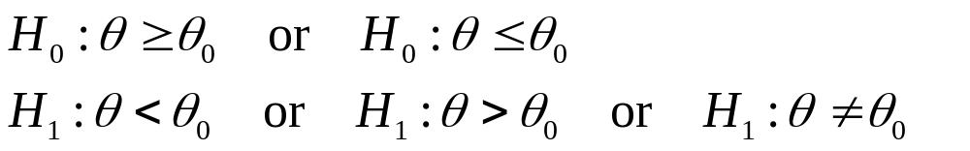
If the set Ωi contains more than one value of θ, then it is said that the hypothesis Hi is a composite hypothesis.
--- It is only specified that the distribution of the observations belongs to a certain class.
E.g.

Slide 14

The t Test
Suppose that X1,…,Xn form a random sample from a normal distribution for which both the mean μ and the variance are unknown.

Slide 15
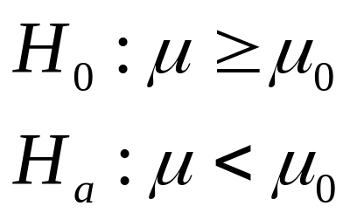
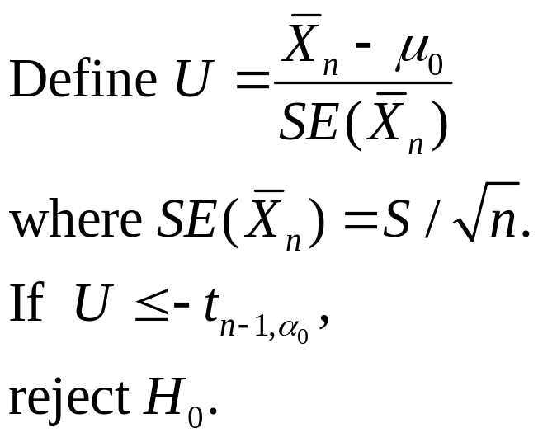
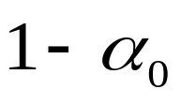

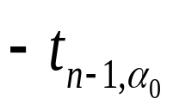


One-sided Test (1): Critical Value Approach

Slide 16
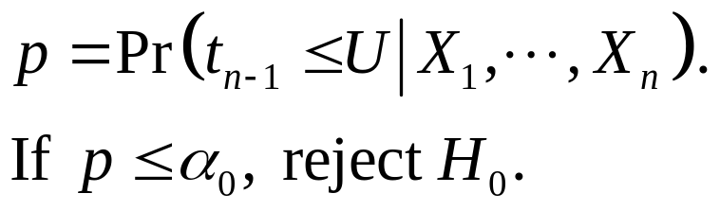
One-sided Test (1): p Value Approach
p
u

Slide 17
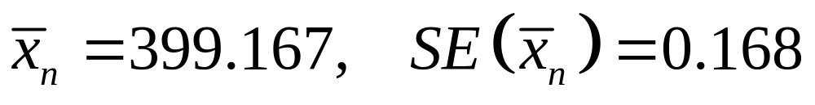
Example 1
Suppose a sample of 36 cans of milk powder is selected to check Cutebaby's claim at level of significance 0.01. It is calculated that

Slide 18
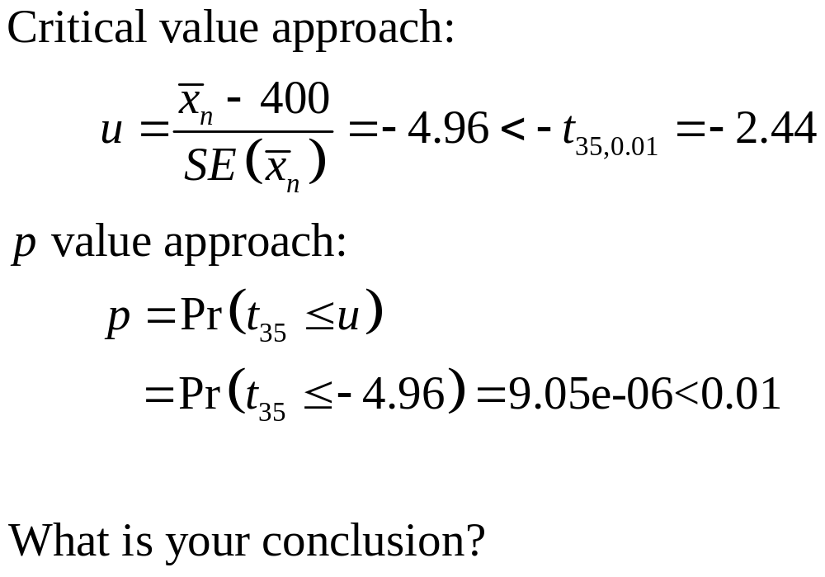
Example 1

Slide 19
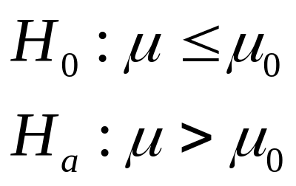
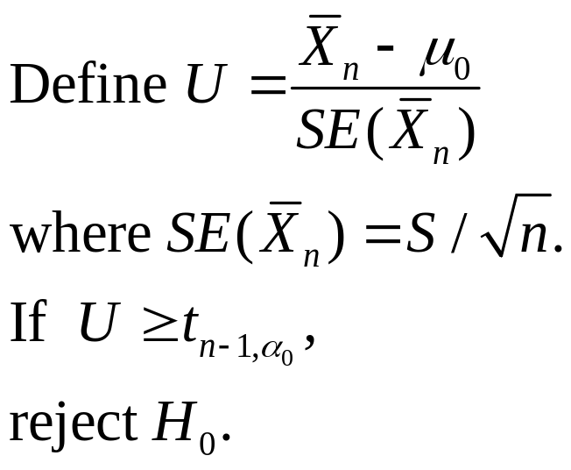
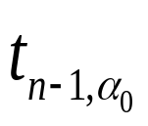
One-sided Test (2): Critical Value Approach

Slide 20

One-sided Test (2): p Value Approach
p
u

Slide 21
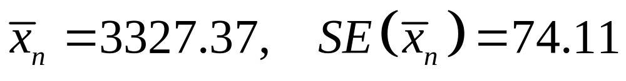
Example 2
Suppose a sample of 180 apartments is selected to check whether the mean apartment rental rate exceeds 3820 yuan at level of significance 0.05. It is calculated that

Slide 22
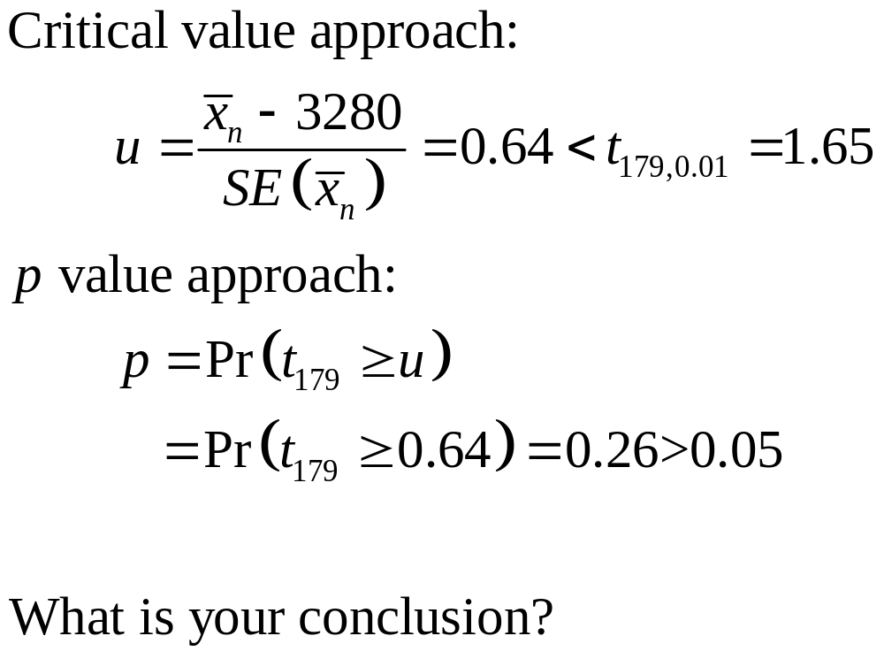
Example 2

Slide 23
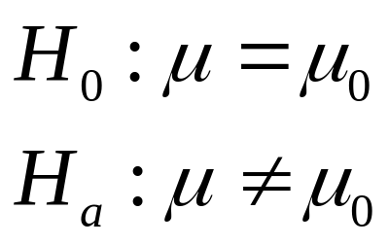

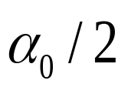
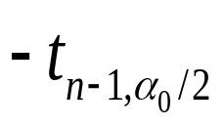
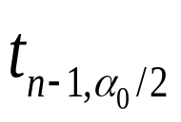
Two-sided Test: Critical Value Approach

Slide 24
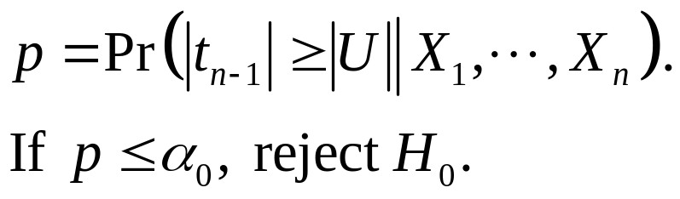


Two-sided Test: p Value Approach
p/2
p/2

Slide 25

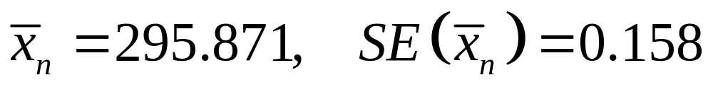
Example 3
Suppose that MaxFlight’s quality control program takes periodic samples of 50 golf balls to monitor the manufacturing process. For one sample, it is calculated that
MaxFlight wants to determine whether the process has fallen out of adjustment at significance level 0.05.

Slide 26
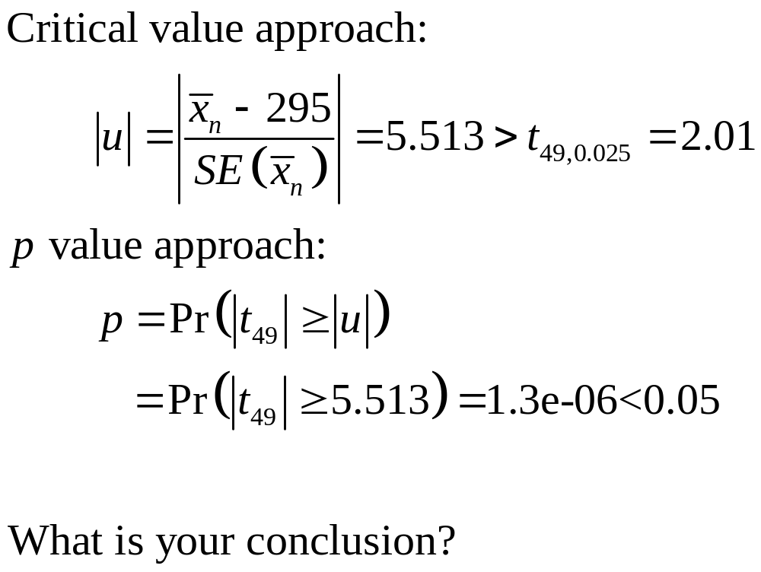
Example 3

Slide 27
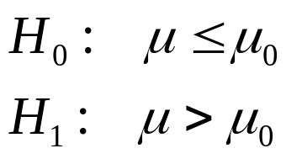
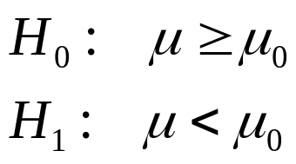
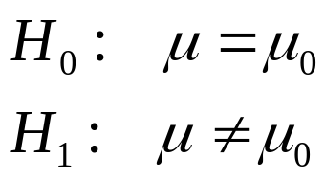
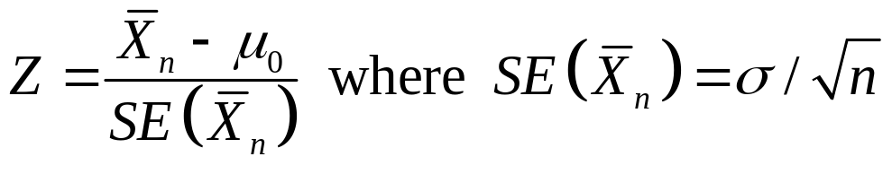
Remark
Suppose that X1,…,Xn form a random sample from a normal distribution for which the mean μ is unknown, but the variance is known. Consider testing the hypotheses:
or or
Let .
You can similarly derive the critical regions as:

